Slide 1

AI for Technical Architects
Day 1: Multi-Agent Systems & Resilient Orchestration
15-Hour Intensive Curriculum • Topologies, State Management, Fault Tolerance, Polyglot Implementation & Enterprise Capstone

Slide 2

Multi-Agent Topologies & Workflow Design
Hierarchical, Peer-to-Peer, Swarm Patterns & Task Decomposition Strategies

Slide 3

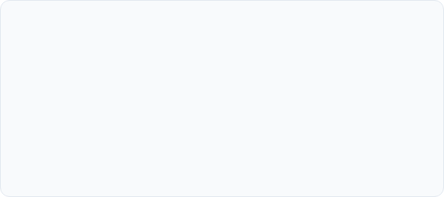
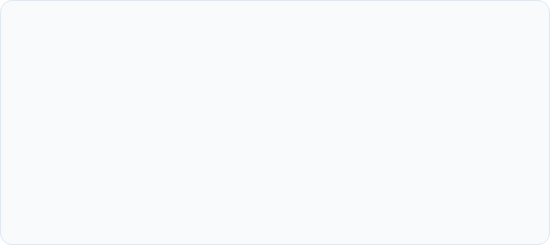
Why Single Agents Fail at Scale
Context Window & Tool Saturation
Architectural Specialization
Single monolithic agents degrade dramatically when managing >15 tools or excessive tokens. Task context becomes contaminated, causing instruction drift, hallucinated parameters, and bloated token costs.
Decomposing monolithic logic into autonomous, specialized agents establishes clear domain boundaries. Each agent operates with focused tool sets, restricted prompts, and explicit validation checks.

Slide 4






Core Multi-Agent Topologies
Hierarchical
Peer-to-Peer (Mesh)
Swarm
Supervisor agent manages sub-agents in a strict tree hierarchy. Ideal for complex multi-domain workflows requiring deterministic oversight and aggregated outcomes.
Decentralized agents negotiate directly via structured protocols without a central orchestrator. Suited for collaborative reasoning and iterative refinement.
Autonomous agents coordinate dynamically through shared state bulletin boards or direct task handoffs. Highly scalable for dynamic research and data processing.

Slide 5
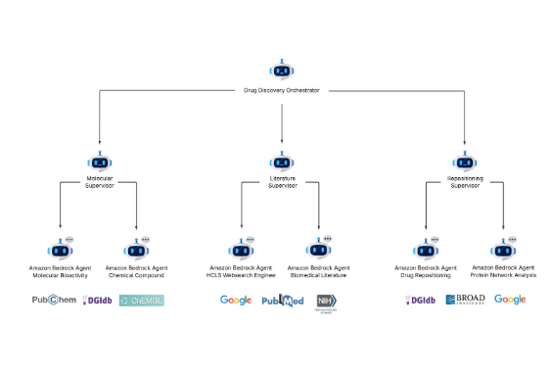
Hierarchical & Supervisor Topology
Centralized Command: Top-level supervisor assesses incoming requests, decomposes goals, and routes subtasks.
Domain Boundaries: Leaf worker agents perform focused operations (e.g., search, SQL generation, synthesis).
Synthesized Output: Workers report strictly back to their manager, eliminating unbounded inter-agent cross-talk.
Latency Accumulation: Processing latency scales with hierarchy depth (6–12s min per level).

Slide 6
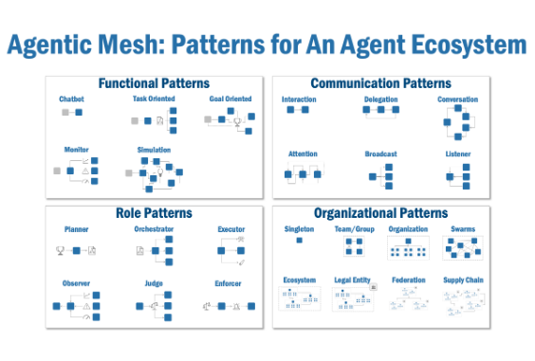
Peer-to-Peer Mesh Topologies
Decentralized Control: Agents communicate directly with peers to negotiate task delegation and share insights.
Contract Negotiation: Agents publish capability contracts via standardized schemas (e.g., JSON-RPC, FIPA-ACL).
Event Streaming: Frequently built over Kafka or Redis Pub/Sub for asynchronous message passing.
Topology Limits: Works optimally for 3–8 agents. Connection complexity grows exponentially (O(N²)).

Slide 7
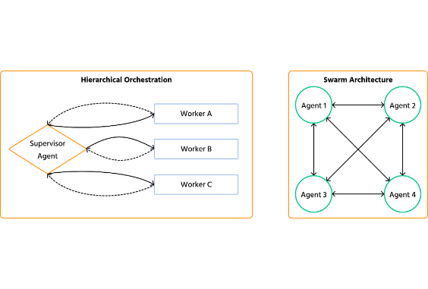
Swarm Architectures & Dynamic Handoffs
Emergent Coordination: Lightweight agents switch context dynamically based on active state and rules.
Handoff Mechanisms: An active agent transfers total control and execution context directly to another specialist.
Blackboard Model: Shared memory store where agents inspect state, post subtask solutions, and pull work.
Governance Challenge: Non-deterministic paths make regulatory compliance and auditing complex.

Slide 8
Enterprise Topology Selection Matrix
Topology Pattern | Control Level | Fault Tolerance | Auditability | Target Enterprise Use Cases
Supervisor / Hierarchy | High (Strict) | Medium | High (Traceable) | Claims Processing, Compliance, Order Fulfillment
Peer-to-Peer Mesh | Medium | High | Medium | Code Review Loops, Collaborative Design, Diagnostics
Swarm / Handoff | Low (Emergent) | High | Low (Complex) | Unstructured Research, Data Mining, Optimization
Sequential Pipeline | High (Deterministic) | Low | High (Linear) | Document ETL, Content Publishing, Batch Reports

Slide 9
Agent Specification & Task Decomposition
Goal Abstraction: Defining atomic subgoals with clear input/output JSON schemas and bounded execution parameters.
Negotiation Strategies: Implementing Contract Net Protocol (CNP) where orchestrators solicit bids from worker agents based on latency and cost.
Role Governance: Strictly assigning tool privileges, maximum recursion steps, and memory isolation per agent.
Synthesizer Patterns: Dedicated evaluator agents verifying worker outputs before passing state downstream.

Slide 10
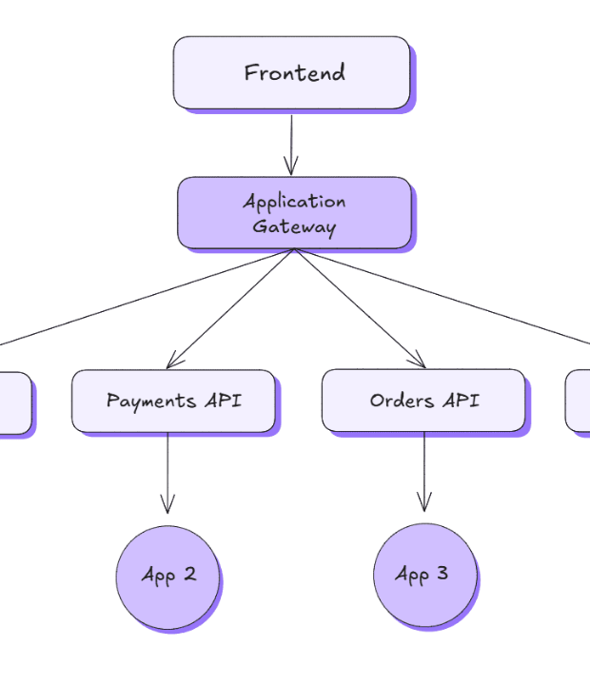
Excalidraw Design Session
P2P Claim Processing Diagram
Work with your group to design a Peer-to-Peer interaction diagram for a multi-service claim processing system using Excalidraw.
Focus on defining message passing formats, fallback paths, and agent boundaries.

Slide 11
Coordination, State Sharing & Circuit Breakers
Message Protocols, Shared Memory, Fallbacks & Systemic Fault Tolerance

Slide 12

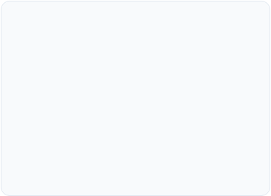
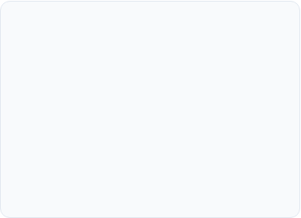
Inter-Agent Messaging Protocols
Pub/Sub Streaming
gRPC & JSON-RPC
FIPA-ACL & Standards
Asynchronous event buses (Redis Streams, Apache Kafka) decoupling agent execution and enabling event-driven reactive updates.
High-performance synchronous RPC for low-latency point-to-point agent coordination with strictly enforced protocol buffer schemas.
Formalized agent communication languages defining explicit performatives (Inform, Request, Propose, Reject) for deterministic dialog.

Slide 13
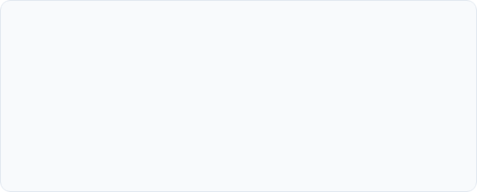
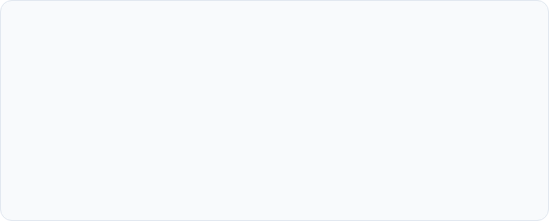
Shared State Storage Strategies
Redis & Key-Value Memory
Vector DBs & Event Sourcing
Ultra-low latency ephemeral state store. Used for short-term working memory, locks, message queues, execution state graphs, and active token counters.
Long-term semantic state and historical memory stores (Pinecone, Qdrant). Combined with immutable append-only event logs for full audit replays.

Slide 14
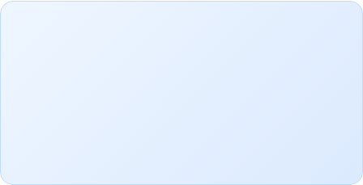
Coordination Overhead Scaling
Managing Communication Overhead
O(N²)
Unconstrained peer-to-peer agent networks experience severe exponential message volume growth as agent count expands. Without centralized event routing or strict sub-mesh boundaries, network throughput degrades and token execution costs skyrocket.
Architects must implement message throttling, channel scoping, and message summarization middleware.
Message Path Complexity

Slide 15
Fault Tolerance & Cascade Prevention
Exponential Backoff Retries: Handling transient API rate limits (HTTP 429) and model provider degradation without flooding endpoints.
Dynamic Fallback Routes: Routing subtasks to lighter/cheaper models or deterministic rule engines if primary LLM fails.
Human-in-the-Loop Escalation: Seamlessly pausing state graph execution to request human intervention when confidence drops below threshold.
State Checkpointing: Saving execution snapshot to persistent storage after every node transition for instant disaster recovery.

Slide 16
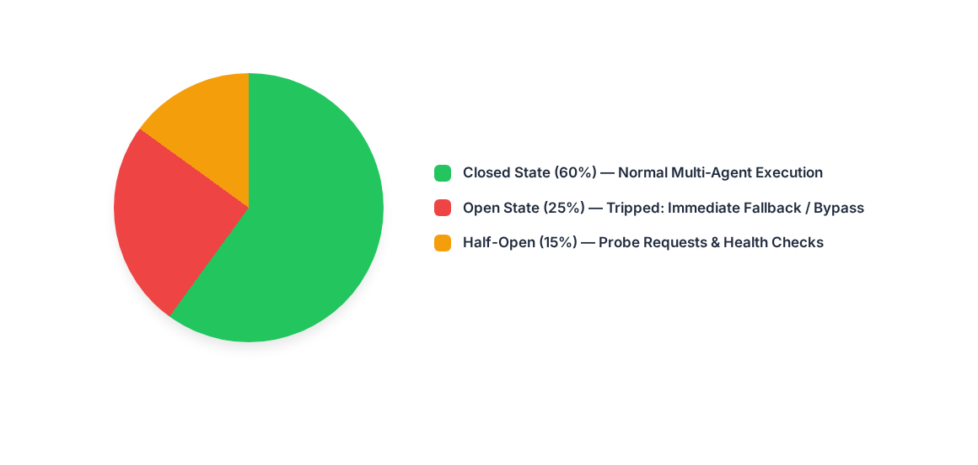
Agent Circuit Breaker Architecture
Circuit breakers automatically isolate failing agents, preventing cascade failures across downstream workers.

Slide 17
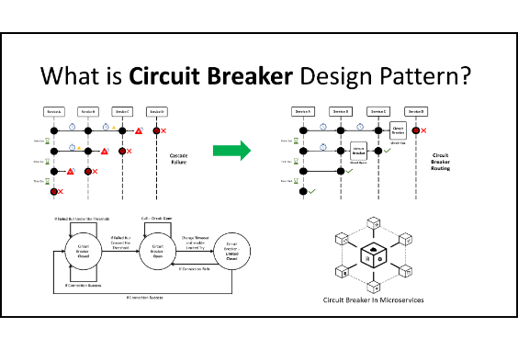
Live Demo: Fault Tolerance & Fallbacks
Simulated Failure: Injected synthetic agent timeout and tool failure into a 3-agent pipeline.
Circuit Breaker Trigger: Automated detection trips circuit, preventing cascading retries.
Fallback Route: Task automatically rerouted to a secondary lightweight agent with backup tools.
Audit Log Capture: Full failure event and resolution sequence logged for observability.

Slide 18

Hands-On: Polyglot Multi-Agent Implementation
Building a Tri-Agent Orchestrator with State Persistence & Human Fallback

Slide 19
The Tri-Agent Orchestrator Pattern
1. Planner Agent
2. Worker Agent
3. Evaluator Agent
Decomposes user query into an execution plan graph. Generates structured JSON subtasks with clear parameters.
Executes domain subtasks utilizing external tools, APIs, and databases. Returns structured execution results.
Validates output quality against business rules. Triggers refinement loops or human fallback on failure.

Slide 20
Polyglot Multi-Agent Frameworks
Language Stack | Recommended Frameworks | State Persistence | Key Enterprise Features
Python | LangGraph, CrewAI, AutoGen | MemorySaver, RedisCheckpointer | Rich AI ecosystem, native graph orchestration
Java | Spring AI, LangChain4j | JDBC / Redis State Store | Enterprise Spring integration, strong typing
.NET / C# | Semantic Kernel, AutoGen .NET | Distributed Cache / Cosmos DB | Native C# async pipelines, Microsoft ecosystem
TypeScript / Node | LangGraph.js, LlamaIndex.TS | Redis / Postgres Checkpointer | Event-loop async scaling, web API integration

Slide 21


[PAUSE] Hands-On Lab Session
Module 1.3: Tri-Agent Orchestrator Implementation
Select your stack (Python / Java / .NET) and open your lab workstation. We will resume the main presentation following the coding exercise.

Slide 22
Capstone Checkpoint 1: Scenario & Multi-Agent Framing
Selecting Enterprise Use Cases, Defining Agent Boundaries & Mapping Topology Blueprints

Slide 23
Enterprise Capstone Scenario Selection
Automated Claims Processing: Multi-agent system evaluating policy coverage, detecting fraud, and calculating payout limits.
IT Operations & Incident Response: Autonomous agents diagnosing infrastructure alerts, executing runbooks, and escalating.
Regulatory Compliance Review: Agents scanning enterprise documents against changing legal frameworks.
Architect Deliverable v1: Map top-level agent boundaries, delegation rules, and primary state store strategy.

Slide 24
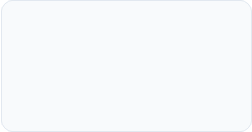
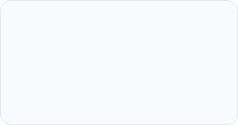
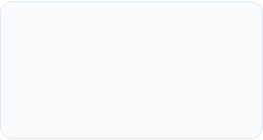
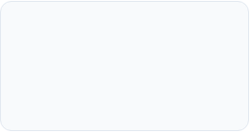
Capstone Architecture Roadmap
Day 2
Day 4-5
MCP Integration & Governance Matrix (v2)
Token Optimization & Final Capstone Defense
Day 1
Day 3
Topology Blueprint & Multi-Agent Framing (v1)
Cloud Deployment & Security Perimeter (v3)

Slide 25
Questions & Discussion
Transitioning to Capstone Working Session v1 Blueprinting
Open Excalidraw Workspace • Enterprise Capstone Checkpoint 1

Slide 26






Image Sources
https://substackcdn.com/image/fetch/$s_!YwR0!,f_auto,q_auto:good,fl_progressive:steep/https%3A%2F%2Fsubstack-post-media.s3.amazonaws.com%2Fpublic%2Fimages%2F89a44326-9caf-45d8-b5cc-321e15b66dbb_1600x823.png
Source: departmentofproduct.substack.com
https://miro.medium.com/1*sykbU66OV5WB3CZpLMofTw.png
Source: medium.com
https://content-media-cdn.codefinity.com/articles/59496e4a-9394-434a-b652-92e8584bda47/architectures_comparing.png
Source: codefinity.com
https://excalidraw.nyc3.cdn.digitaloceanspaces.com/lp-cms/media/Software%20Architecture%20Diagrams%20-%20a%20microservices%20pattern.png
Source: plus.excalidraw.com
https://digitalvarys.com/wp-content/uploads/2019/09/Circuit-Breaker-Design-Pattern.png
Source: digitalvarys.com
https://pxl-lboroacuk.terminalfour.net/fit-in/1280x720/filters:quality(80)/filters:format(webp)/0x0:1280x720/prod01/lboro-cdn-pxl-media/media/media/study/ug/2027/courseheroimages/d6340-4043-engineering-physics-bsc-1280X720.jpg
Source: www.lboro.ac.uk

